Slide 1
Mastering Python
Programming Language
Prepared by: Ahmed Abdelaziz

Slide 2
what is Python Programming Language?
Readability -> indentation rather than brackets
Simplicity -> easy to use and readable syntax
Interpreted -> executed line by line (rapid development and debugging )
Multi-paradigm -> oop and functional make it flex.
Cross platform
Strong community

Slide 3
Why Python?
Easy to install
Clean and easy
Expressive
Error handling
Debugging
Oop
Integrated
Support modules and packages
Large set of library and plugins

Slide 4
Print(“Hello world”)

Slide 5
Comments
Comments are non-executable text used to provide documentation for the code.
allowing others to better understand what the code was intended to accomplish.
It is always recommended to use comments in your code, at least one comment for each code line.
Single-line comment Any line preceded by #
Multi-line comment Any text starts with “”” and ends with “””

Slide 6
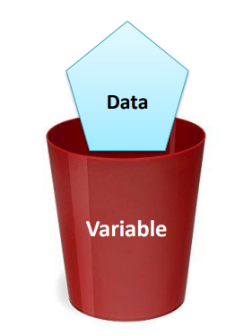
Variables
Variable is a part from the memory, used to hold a piece of data.
The variable has a type, name and value.
Syntax
name = initial_value
X = 10 # defining integer and initializing it by 10
Y = “ Hello “ # defining string
F = True # defining Boolean and initializing it by True

Slide 7
Strings
string is represented between double or single quotation “ this is string ” ‘ this is string ’
Print method will print the string passed to it as it is.
Escape operator may be used inside the string \ , this operator may insert tab, new line or quotes.
Print (“ My Name Is Ahmed \n “) # \n for new line
Print (“ I am 21 years Old”)

Slide 8
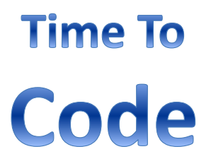
Lab 1
Write a python code that will print your short biography.
Full Name, Birth Year, and Faculty
Expected output
I’m Ahmed Abdelaziz Ali
My age is 21
I’m studying aerospace engineering Cairo university

Slide 9
Variable naming rule
Variable can contain: 1. Capital Letters A to Z 2. Small Letters a to z 3. Numbers 0 to 9 4. Underscore _
First Character must be alphabet or Underscore a1 =9 # allowed 1a =9 # not allowed
Blanks & Commas are not allowed
No Special Symbols other than underscore are allowed, ex ?, #, ….. Etc
Variable name can’t be repeated in the same scope “Will be clarified later”

Slide 10

Question
What will be the output of the following code … ?
X = 10 # define integer and initializing it by 10
Print(“the variable value is X”)

Slide 11
Printing a variable
X = 10
Print method can print a variable inside the string, it could be done by inserting format specifier that will be replaced by the values specified in subsequent additional arguments
Example print(f ”The variable value is { X } ”) or print(”The variable value is %d ” %(X))
Common specifier used - %s for string - %d for integer - %f for float

Slide 12
Input a data from user
Syntax
Input() # to input string int(input()) # to input integer
float(input()) #to input float

Slide 13
Lab 2
Write a code that will ask the user to enter a value then print it.
Expected output
Please enter a value: 10 The value you entered is 10

Slide 14
Arithmatic operation
X = 10
Y = 5
Summation example sum = X + Y # sum= 15
Subtraction example sub = X - Y # sub = 5
Multiplication example mul = X * Y # mul= 50
Division example div = X / Y # div=2

Slide 15
Arithmatic operation
X = 10
Y = 5
Modulus ( reminder ) example mod = X % Y # mod= 0 example mod = Y % X # mod = 5 example mod = 10 % 3 # mod = 1 example mod = 9 % 1 # mod = 0 example mod = 17 % 9 # mod = 8

Slide 16
Lab 3
Write a code that will ask the user to enter two values and print their summation and multiplication.
Expected output
Please enter number 1: 10 Please enter number 2: 20 a + b= 30 a*b= 200

Slide 17
Arithmatic operation
X = 10
Increment example Y=X++ # X=11, Y=10 assign to Y then increase X example Y=++X # X=11, Y=11 increase X then assign to Y
Decrement example Y=X-- # X=9, Y=10 assign to Y then decrease X example Y=--X # X=9, Y=9 decrease X then assign to Y

Slide 18


True and false in python
True
False
Any number except 0
0

Slide 19
Comparison operators
X = 10
Y = 5
Check Equality Example X == Y # check if X equals to Y and will return false
Check Not Equality Example X != Y # check if X not equals to Y and will return true
Check More Than Example X > Y # check if X greater than Y and will return true
Check More Than or equal Example X >= Y # check if X greater than or equal to Y and will return true
Check less Than Example X < Y # check if X less than Y and will return false

Slide 20
Comparison operators
X = 10
Y = 5
Check less Than or equal Example X < =Y # check if X less than or equal to Y and will return false

Slide 21
Logical operators
X = 10
Y = 5
These operators are used to apply logical operation between two values, each value will be considered either false if it is 0 or true if it is not 0.
Logical And Example X =3 and 0 # 3 is true and 0 is false -> True and false is false so X=0
Logical OR Example X =3 or 0 # 3 is true and 0 is false -> True or false is true so X=3
Logical Not Example X = not 3 # 3 is true -> not True is false so X=False

Slide 22
Assignment operators
X = 10
Assign Example X =20 # assign 20 to X
Add and assign Example X +=3 # add 3 then assign it to X will equal 13
subtract and assign Example X -= 4 # subtract 3 then assign it to X will equal 6
Multiply and Assign Example X *= 4 # multiply X by 4 then assign it to X will equal 40

Slide 23
Assignment operators
X = 10
divide and assign Example X /=2 # divide X by 2 and assign it to X will equal 5
Modulus and assign Example X %=4 # get the reminder of X divided by 4 and assign it to X will be 2
power and assign Example X **= 4 # x power 4 then assign it to X will equal 10000

Slide 24
Small intro on if condition
Example if condition : bla bla # if condition is True do this elif condition : bla bla # the other condition is True do this else: bla bla # other wise do this

Slide 25
Lab 5
Write a code that scan 3 numbers from the user and print them in reversed order
Expected output
Please enter number 1: 10 Please enter number 2: 20
Please enter number 3: 30 number 3 is 30 number 2 is 20
number 1 is 10

Slide 26
Lab 6
Write a code that give the use 5 choices Add, subtraction, multiplication, division, and modulus and take from user 3 inputs 1.operation
2.First number
3.Second number
Then return the results
Expected output
Please choose the operation:
1.Addition 2.subtraction 3.multiplication 4.division 5.modulus
your choice is : 1 or addition please enter first number:5 please enter second number:10 the result is 15

Slide 27
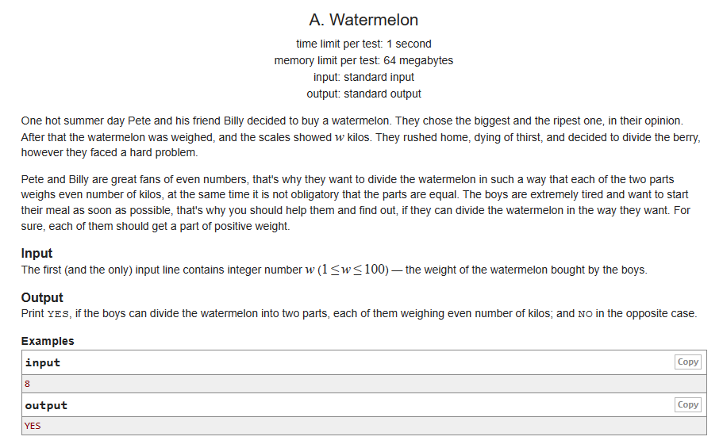

Slide 28
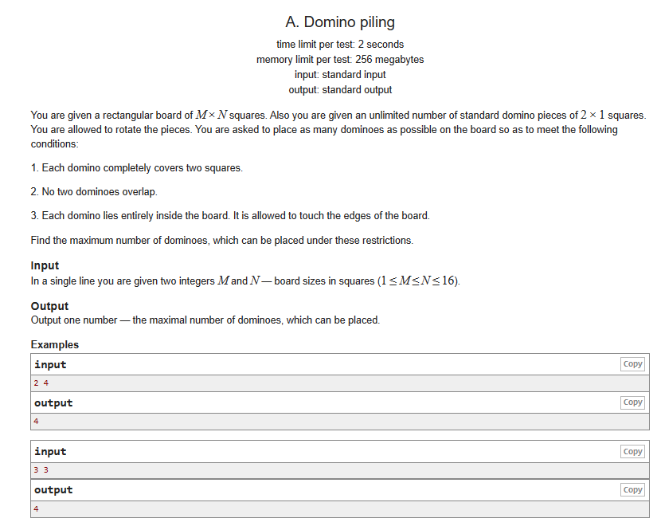

Slide 29
